Slide 1

GOLD PRICE FORECASTING
GOLD PRICE FORECASTING
PRESENTED BY:
MOUNIKA PARIKIPANDLA
Notes:
ID=d924773e-9a16-4d6d-9803-8cb819e99682 Recipe=text_billboard Type=TextOnly Variant=0 FamilyID=AccentBoxWalbaum_Zero

Slide 2

OBJECTIVE
Analyze past gold price trends.
Identify influencing factors.
Apply forecasting models.
Predict future gold prices.
Support investment decisions

Slide 3
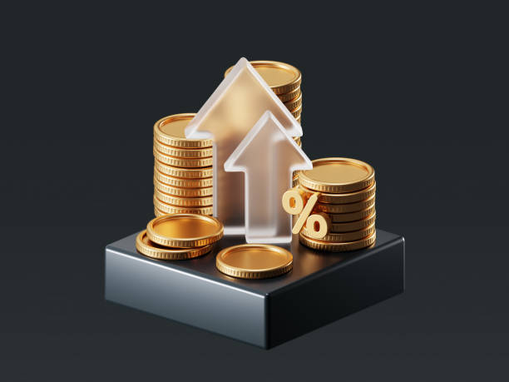
DATA OVERVIEW
Historical gold prices (daily/monthly/yearly)
Attributes:DateOpen, High, Low, Close prices.
Volume
Time period: (e.g., 2010–2024)
Data format: CSV / Excel

Slide 4
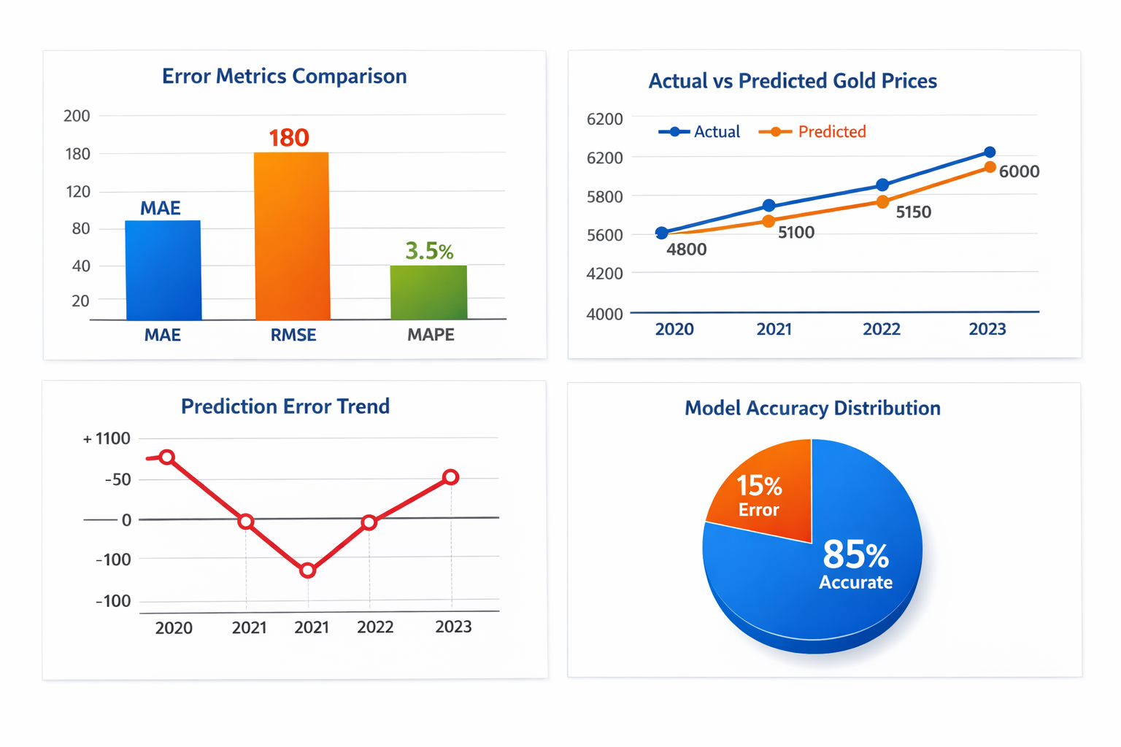
KEYPERFORMANCE INDICATORS(KPI’S)
These charts show the accuracy and performance of the gold price forecasting model by comparing predicted values with actual data

Slide 5
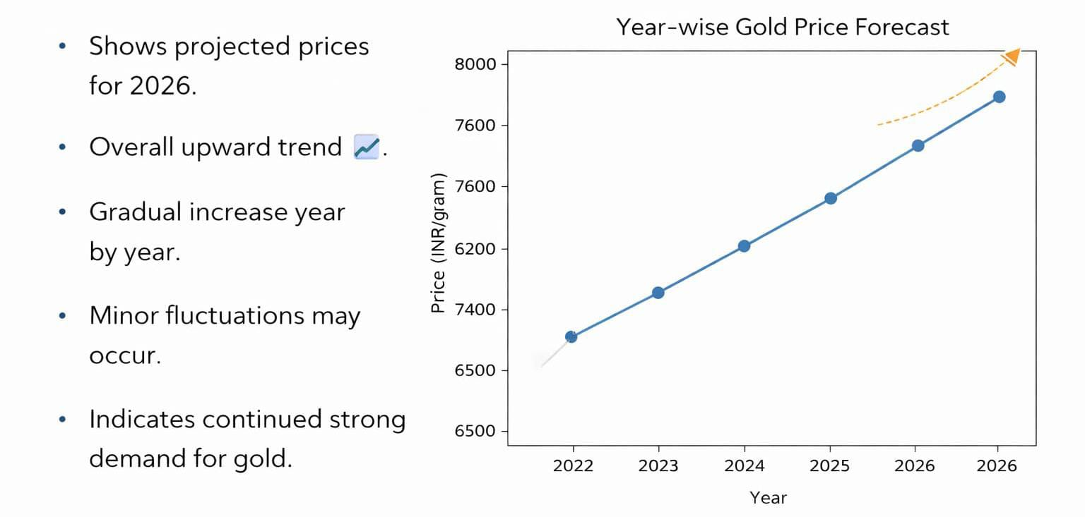
GOLD PRICE TREND

Slide 6
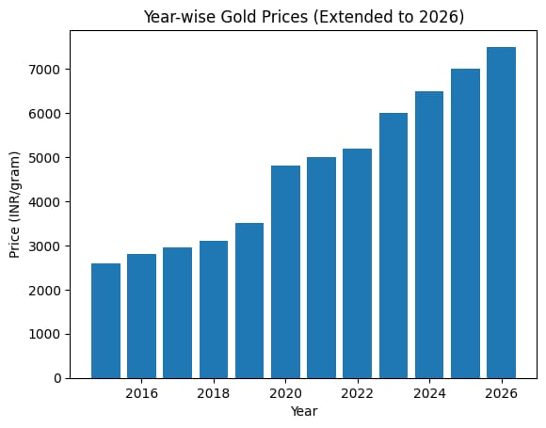
YEAR – WISE GOLD PRICES
Gold prices rise overall from 2015 to 2026 📈
2015–2019: Slow increase
2020: Big jump
2021–2022: Steady growth
2023–2026: Strong rise
Conclusion:
Gold value generally increases over time

Slide 7
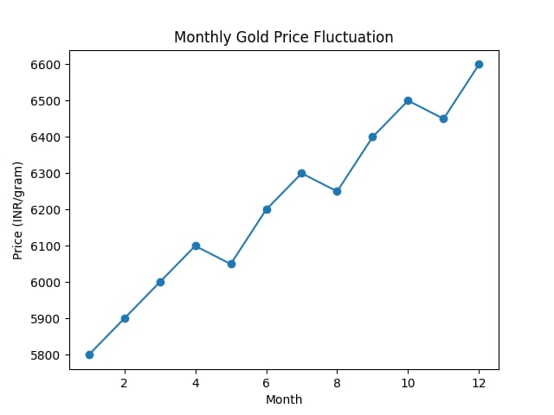
MONTHLY PRICE FLUCTUATION
Shows month-wise changes in gold prices.
Prices gradually increase over months 📈.
Some small fluctuations (ups & downs) in between.
Highest price in last months (Nov–Dec)

Slide 8
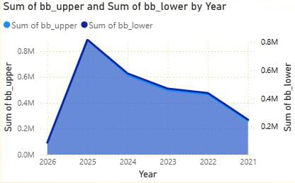
YEAR-WISE TREND OF UPPER AND LOWER BANDS
Year-wise Trend of Upper and Lower Bands.
Annual Bollinger Band Analysis.
Yearly Upper vs Lower Value Trend.
TrendAnalysis of bb_upper and bb_lower.
Year-wise Volatility Range Analysis

Slide 9
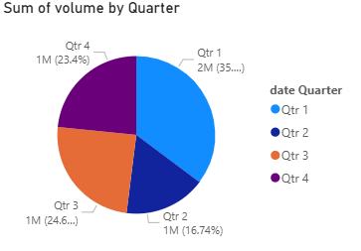
QUARTERLY VOLUME DISTRIBUTION
Shows how total volume is divided across 4 quarters.
Qtr 1 has the highest contribution.
Qtr 3 and Qtr 4 have moderate shares.
Qtr 2 has the lowest contribution.
Helps in understanding seasonal trends in volume.

Slide 10
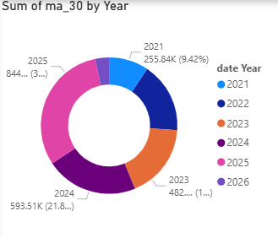
YEARLY MOVING AVERAGE(MA 30) DISTRIBUTION
Shows MA 30 values across different years.
2025 has the highest contribution.
2024 and 2023 show steady increase.
2022 and 2021 have lower values.
Indicates an overall upward trend in prices

Slide 11
FACTORS AFFECTING GOLD PRICES
Inflation
Interest rates
Currency value (USD)
Demand & supply
Geopolitical events

Slide 12
INSIGHTS AND RECOMMENDATIONS
Insights:
Gold prices increase during inflation & crises.
Inverse relation with USD & interest rates.
Strong long-term upward trend.
Recommendations:
Use ARIMA + ML models (LSTM) for better prediction.
Include factors like inflation, interest rates, USD
Invest during uncertainty, avoid high-rate periods
Diversify portfolio for safety
Takeaway:
Gold is a safe long-term asset with price driven by economic factors.

Slide 13
THANK YOU

